Slide 1
Command & Code Injection

Slide 2
Objectives
Command Injection
Description
Examples
Code Injection
Description
Examples
Command/Code Injection Remedies
Code VS Command Injection
Hands-on Exercise

Slide 3
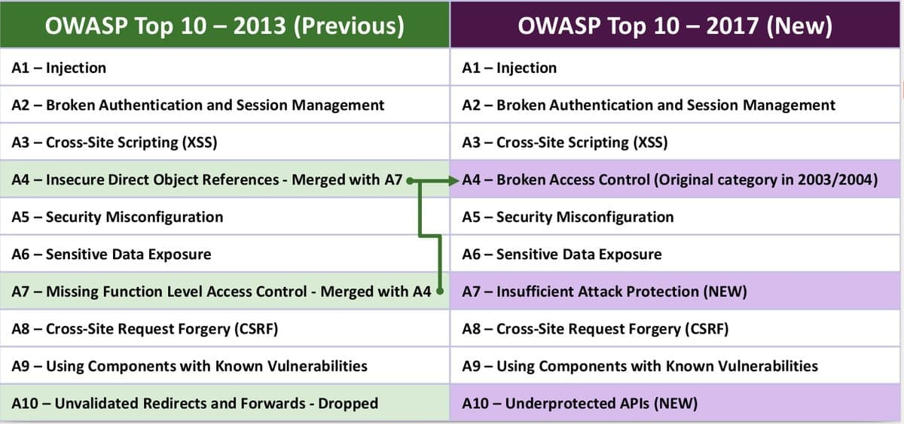
https://www.owasp.org/images/7/72/OWASP_Top_10-2017_%28en%29.pdf.pdf

Slide 4
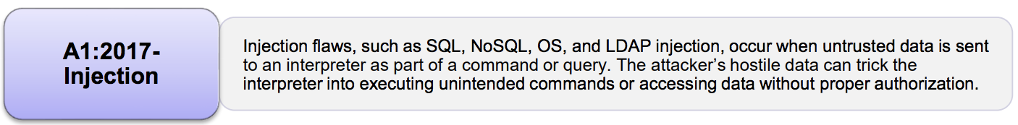
A1:2017 - Injection
Injection flaws allow attackers to relay malicious code through an application to another system:
calls to backend databases via SQL (i.e., SQL injection);
calls to the operating system via system calls;
use of external programs via shell commands.
Any time an application uses an interpreter of any type there is a danger of introducing an injection vulnerability.
https://www.owasp.org/images/7/72/OWASP_Top_10-2017_%28en%29.pdf.pdf
Notes:
Whole scripts written in Perl, Python, and other languages can be injected into poorly designed applications and executed.

Slide 5
Command Injection
An attack in which the goal is execution of arbitrary commands on the host operating system via a vulnerable application.
It is possible when an application passes unsafe user supplied data (forms, cookies, HTTP headers, etc.) to a system shell.
The attacker-supplied operating system commands are usually executed with the privileges of the vulnerable application.
This attack is possible largely due to insufficient input validation.
https://www.owasp.org/index.php/Command_Injection
Notes:
Whole scripts written in Perl, Python, and other languages can be injected into poorly designed applications and executed.

Slide 6
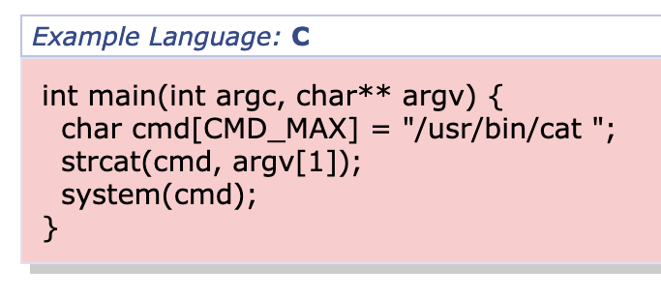
Command Injection Example 1
Accepts a filename as a command line argument and displays the contents of the file back to the user.
Executed with the root privileges to allow system administrators in-training to inspect privileged system files without giving them the ability to modify them or damage the system
http://cwe.mitre.org/data/definitions/77.html
Notes:
Whole scripts written in Perl, Python, and other languages can be injected into poorly designed applications and executed.

Slide 7
Command Injection Example 1
Accepts a filename as a command line argument and displays the contents of the file back to the user.
Executed with the root privileges to allow system administrators in-training to inspect privileged system files without giving them the ability to modify them or damage the system
Executed with the root privileges
http://cwe.mitre.org/data/definitions/77.html
Notes:
Whole scripts written in Perl, Python, and other languages can be injected into poorly designed applications and executed.

Slide 8
Command Injection Example 1
Accepts a filename as a command line argument and displays the contents of the file back to the user.
Executed with the root privileges to allow system administrators in-training to inspect privileged system files without giving them the ability to modify them or damage the system
“; rm –rf /”
Fails to execute cat due to lack of arguments and then plows on to recursively delete the contents of the root partition
http://cwe.mitre.org/data/definitions/77.html
Notes:
Whole scripts written in Perl, Python, and other languages can be injected into poorly designed applications and executed.

Slide 9
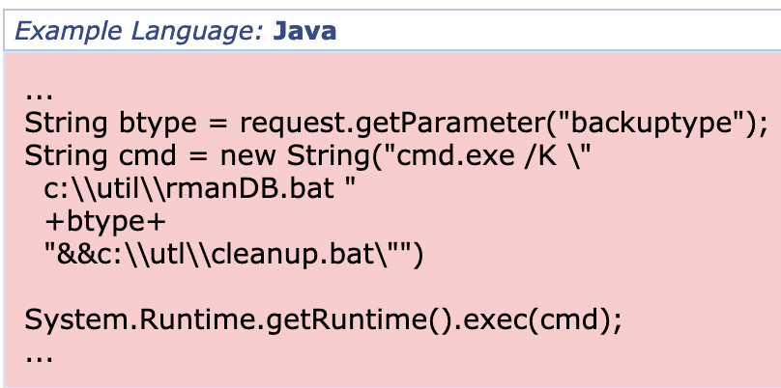
Command Injection Example 2
This code is from an administrative web application designed to allow users to kick off a backup of an Oracle database using a batch-file wrapper around the rman utility and the run a cleanup.bat script to delete some temporary files.
The script rmanDB.bat accepts a single command line parameter, which specifies what type of backup to perform.
Because access to the database is restricted, the application runs the backup as a privileged user.
http://cwe.mitre.org/data/definitions/77.html
Notes:
Whole scripts written in Perl, Python, and other languages can be injected into poorly designed applications and executed.

Slide 10
Command Injection Example 2
This code is from an administrative web application designed to allow users to kick off a backup of an Oracle database using a batch-file wrapper around the rman utility and the run a cleanup.bat script to delete some temporary files.
The script rmanDB.bat accepts a single command line parameter, which specifies what type of backup to perform.
Because access to the database is restricted, the application runs the backup as a privileged user.
No validation is performed on the backup type parameter
http://cwe.mitre.org/data/definitions/77.html
Notes:
Whole scripts written in Perl, Python, and other languages can be injected into poorly designed applications and executed.

Slide 11
Command Injection Example 2
This code is from an administrative web application designed to allow users to kick off a backup of an Oracle database using a batch-file wrapper around the rman utility and the run a cleanup.bat script to delete some temporary files.
The script rmanDB.bat accepts a single command line parameter, which specifies what type of backup to perform.
Because access to the database is restricted, the application runs the backup as a privileged user.
Runtime.exec() does not allow execution of multiple commands
http://cwe.mitre.org/data/definitions/77.html
Notes:
Whole scripts written in Perl, Python, and other languages can be injected into poorly designed applications and executed.

Slide 12
Command Injection Example 2
This code is from an administrative web application designed to allow users to kick off a backup of an Oracle database using a batch-file wrapper around the rman utility and the run a cleanup.bat script to delete some temporary files.
The script rmanDB.bat accepts a single command line parameter, which specifies what type of backup to perform.
Because access to the database is restricted, the application runs the backup as a privileged user.
In this case the application runs cmd.exe to support the execution of multiple commands
http://cwe.mitre.org/data/definitions/77.html
Notes:
Whatever command is injected it will run with the user privilege as well
Rman can backup, recover and restore existing Oracle database instances.

Slide 13
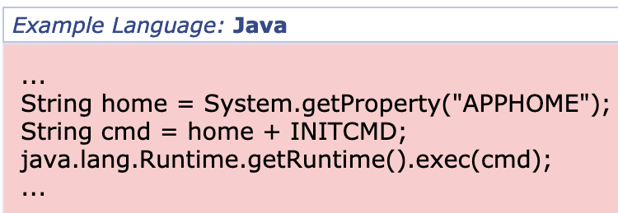
Command Injection Example 3
A system utility uses property APPHOME to determine the directory in which it is installed.
Then it executes an initialization script based on a relative path from the specified directory.
If an attacker has the possibility to change the value of the environment variable APPHOME, it can execute arbitrary commands.
http://cwe.mitre.org/data/definitions/77.html
Notes:
Whole scripts written in Perl, Python, and other languages can be injected into poorly designed applications and executed.

Slide 14
Example 4
The ping functionality is notoriously insecure. A command function exists that passes an IP address the user specifies to the system’s ping command.
ping –c 5 127.0.0.1
An attacker can use this functionality to execute his/her own commands
ping –c 5 127.0.0.1; id
The id command is executed immediately after the ping
https://www.netsparker.com/blog/web-security/command-injection-vulnerability/
Notes:
Id prints username and group information for a specified user or for the current user if the user is omitted.

Slide 15
Command Injection in the News
Red Hat Linux DHCP client found vulnerable to Command Injection attacks
DHCP Client
DHCP Server
Network configuration parameters (e.g., IP address and DNS server)
CVE-2018-1111
https://thehackernews.com/2018/05/linux-dhcp-hacking.html
Notes:
Whole scripts written in Perl, Python, and other languages can be injected into poorly designed applications and executed.

Slide 16
Code Injection
An attack which consist of injecting code that is then interpreted/executed by the application
There are couple of ways in which Java code could be injected into an application, such as using the scripting API or dynamic JSP includes.
Java provides a scripting API that allows code written in scripting languages to access and control Java objects.
https://www.owasp.org/index.php/Code_injection_in_Java
Notes:
Whole scripts written in Perl, Python, and other languages can be injected into poorly designed applications and executed.

Slide 17
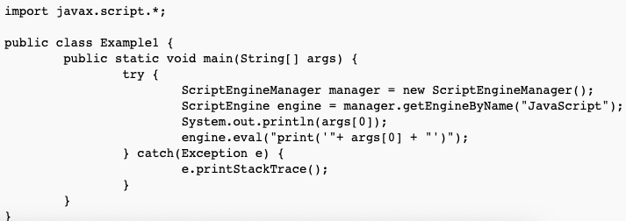
Code Injection – Example 1
Executes arbitrary code using the JavaScript Engine
https://www.owasp.org/index.php/Code_injection_in_Java
Notes:
Whole scripts written in Perl, Python, and other languages can be injected into poorly designed applications and executed.

Slide 18
Code Injection – Example 1
hallo'); var fImport = new JavaImporter(java.io.File); with(fImport) { var f = new File('new'); f.createNewFile(); } //
print(‘hallo');
var fImport = new JavaImporter(java.io.File);
with(fImport) { var f = new File('new'); f.createNewFile(); } //
https://www.owasp.org/index.php/Code_injection_in_Java
Notes:
JavaImporter allows multiple Java packages to be imported in the Script

Slide 19
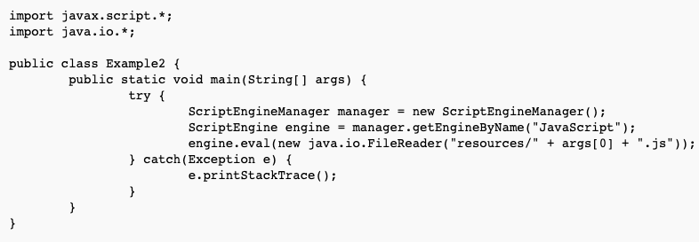
Code Injection – Example 2
uploads/evil)
../uploads/evil
The code below allows a user to control which file is loaded into Java's script engine.
https://www.owasp.org/index.php/Code_injection_in_Java
Notes:
JavaImporter allows multiple Java packages to be imported in the Script

Slide 20
Remedies
Command injection: the attacker extends the default functionality of the application which executes system commands, without the necessity of injecting code.
Code injection: the attacker adds his/her own code that is then executed by the application.
An attacker is only limited by the functionality of the injected language itself (e.g., JavaScript or PHP).
https://www.owasp.org/index.php/Command_Injection
Notes:
Whole scripts written in Perl, Python, and other languages can be injected into poorly designed applications and executed.

Slide 21
Command/Code Injection - Remedies
If possible use library calls rather than external processes
Ensure that all external commands called from the program are statically created
Perform input validation
Use a whitelist of acceptable inputs
Consider all relevant properties, including length, type of input , range of acceptable values
Assign permissions to the software systems that prevent the user from accessing/opening privileged files
Notes:
Whole scripts written in Perl, Python, and other languages can be injected into poorly designed applications and executed.

Slide 22
Command VS Code Injection
Command injection: the attacker extends the default functionality of the application which executes system commands, without the necessity of injecting code.
Code injection: the attacker adds his/her own code that is then executed by the application.
An attacker is only limited by the functionality of the injected language itself (e.g., JavaScript or PHP).
https://www.owasp.org/index.php/Command_Injection
Notes:
Whole scripts written in Perl, Python, and other languages can be injected into poorly designed applications and executed.

Slide 23
Hands-On Exercise

Slide 24
Developers should avoid using raw input data to construct code. If code generation depends on external input predefined choices should be used.

Slide 25
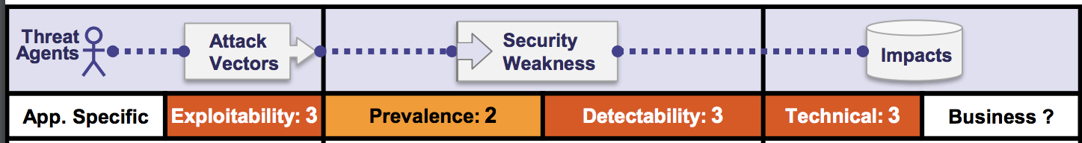
Exploitability
Almost any source of data can be an injection vector:
Environment variables
Parameters
External and internal web services
All types of users.
https://www.owasp.org/images/7/72/OWASP_Top_10-2017_%28en%29.pdf.pdf

Slide 26
Prevalence & Detectability
Often found in SQL, LDAP, XPath, or NoSQL queries, OS commands, XML parsers, SMTP headers, expression languages, and ORM queries.
Prevalent also in legacy code
Injection flaws are easy to discover when examining code.
Scanners and fuzzers can help attackers find injection flaws.
Notes:
Fuzz testing (fuzzing) is a quality assurance technique used to discover coding errors and security loopholes in software, operating systems or networks. It involves inputting massive amounts of random data, called fuzz, to the test subject in an attempt to make it crash.

Slide 27
Technical Impact
Loss of Integrity: data loss and/or corruption
Loss of Confidentiality: disclosure of data to unauthorized parties
Loss of availability: denial of access; Injection can sometimes lead to complete host takeover.
Loss of accountability:
The business impact depends on the needs of the application and data.

Slide 28
SQL Injection Attack

Slide 29
SQLInjection Attack
Insertion or “injection” of malicious data via the SQL query input from the client to the application.
A successful SQL injection exploit can:
read and modify sensitive data from the database;
execute administration operations on the database:
Shutdown auditing or the DBMS itself;
Truncate tables and logs
Add users
Recover the content of a given file present on the DBMS file system
Issue commands to the operating system
Notes:
The proposed ranking is based on years of experience that Gary McGraw acquired by applying touchpoints to many different types of organizations ranging from independent software vendors to huge credit card consortium

Slide 30
Consequences of SQL Injection
SQL injection attacks allow attackers to:
Spoof identity,
Tamper with existing data
cause repudiation issues such as voiding transactions or changing balances
allow the complete disclosure of all data on the system
destroy the data or make it otherwise unavailabale, and become administrators of the database server
SQL Injection is more common in PHP, classic ASP, Cold Fusion and older languages:
Languages that do not provide parameterized query support
Parameterized queries have been added to newer versions
Early adopters of web technology (i.e. Old Code)

Slide 31
Severity of SQL Injection
The severity of SQL Injection attacks is limited by
Attacker’s skill and imagination
Defense in depth countermeasures:
Input validation
Least privilege
Database technology
Not all databases support command chaining
Microsoft Access
MySQL Connector/J and C
Oracle

Slide 32
Example of SQL Injection
Dynamic query in application
Potential String Injection
Potential Numeric Injection
Notes:
The proposed ranking is based on years of experience that Gary McGraw acquired by applying touchpoints to many different types of organizations ranging from independent software vendors to huge credit card consortium

Slide 33
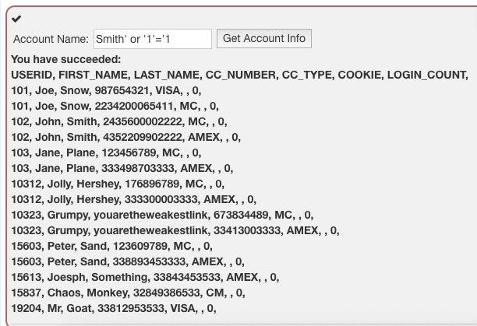
String Injection
Attacker supplies unexpected text
select * from users where name = ‘Smit’ or ‘1’ = ‘1’
Notes:
The proposed ranking is based on years of experience that Gary McGraw acquired by applying touchpoints to many different types of organizations ranging from independent software vendors to huge credit card consortium

Slide 34
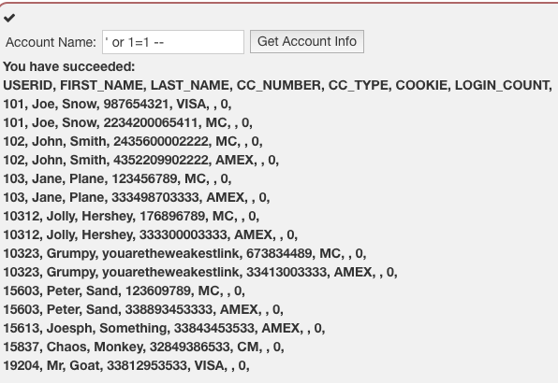
String Injection
Attacker supplies unexpected text
select * from users where name = ‘’ or 1 = 1--’;
Notes:
The proposed ranking is based on years of experience that Gary McGraw acquired by applying touchpoints to many different types of organizations ranging from independent software vendors to huge credit card consortium

Slide 35
String Injection
Attacker supplies unexpected text
select * from users where name = ‘’ or 1 = 1--’;
Notes:
The proposed ranking is based on years of experience that Gary McGraw acquired by applying touchpoints to many different types of organizations ranging from independent software vendors to huge credit card consortium

Slide 36
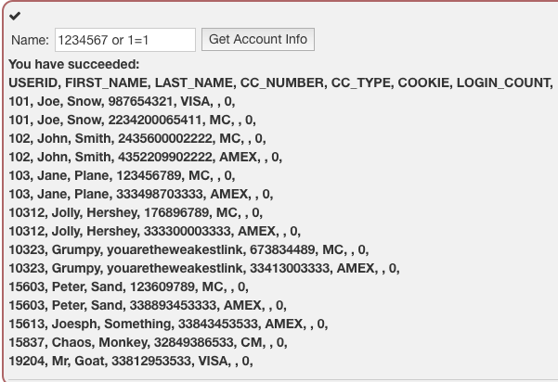
Numeric Injection
Attacker supplies unexpected text
select * from users where employee_id = 1234567 or 1=1;
Notes:
The proposed ranking is based on years of experience that Gary McGraw acquired by applying touchpoints to many different types of organizations ranging from independent software vendors to huge credit card consortium

Slide 37

String Injection
Attacker supplies unexpected text
Smith’; drop table users; truncate audit_log;--
select * from users where name = ‘Smith’; drop table users; truncate audit_log;--’;
Notes:
The proposed ranking is based on years of experience that Gary McGraw acquired by applying touchpoints to many different types of organizations ranging from independent software vendors to huge credit card consortium

Slide 38
Try it Yourself
Download Webgoat
https://github.com/WebGoat/WebGoat/releases
Execute it
java -jar webgoat-server-8.0.0.VERSION.jar [--server.port=8080] [--server.address=localhost]
Using your Browser go to:
http://localhost:8080/WebGoat/start.mvc#lesson/SqlInjection.lesson/6
Notes:
The proposed ranking is based on years of experience that Gary McGraw acquired by applying touchpoints to many different types of organizations ranging from independent software vendors to huge credit card consortium

Slide 39
Test For SQLInjection
Understand when the application interacts with a DB Server in order to access some data.
Authentication forms: when authentication is performed using a web form, chances are that the user credentials are checked against a database that contains all usernames and password
Search engines: the string submitted by the user could be used in a SQL query that extracts all relevant records from a database
E-Commerce sites: the products and their characteristics (price, description , availability, etc.) are very likely to be stored in a database
Notes:
The proposed ranking is based on years of experience that Gary McGraw acquired by applying touchpoints to many different types of organizations ranging from independent software vendors to huge credit card consortium

Slide 40
Test For SQLInjection
The first very test usually consists of adding a single quote or a smicolon to the filed or parameter under test.
The first is used in SQL as a string terminator and, if note filtered by the application, would lead to an incorrect query. The second is used to end a SQL statement and, if it is not filtered, it is also likely to generate an error
Notes:
The proposed ranking is based on years of experience that Gary McGraw acquired by applying touchpoints to many different types of organizations ranging from independent software vendors to huge credit card consortium

Slide 41
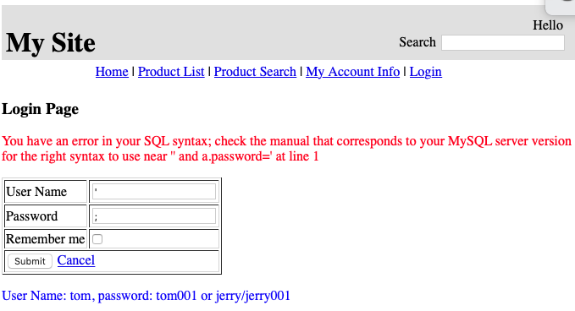
Test For SQLInjection
Notes:
The proposed ranking is based on years of experience that Gary McGraw acquired by applying touchpoints to many different types of organizations ranging from independent software vendors to huge credit card consortium

Slide 42
Try It Yourself
Download from Week 4 -> Lab Material
_menu.jsp
DBUtils.java
MySQLConnUtils.java
ProductSearchServlet.java
loginView.jsp
searchProductView.jsp
Notes:
The proposed ranking is based on years of experience that Gary McGraw acquired by applying touchpoints to many different types of organizations ranging from independent software vendors to huge credit card consortium

Slide 43
Try It Yourself
Place .jsp files in folder views
_menu.jsp
DBUtils.java
MySQLConnUtils.java
ProductSearchServlet.java
loginView.jsp
searchProductView.jsp
Notes:
The proposed ranking is based on years of experience that Gary McGraw acquired by applying touchpoints to many different types of organizations ranging from independent software vendors to huge credit card consortium

Slide 44
Try It Yourself
Place the new servlet in the servlet package
_menu.jsp
DBUtils.java
MySQLConnUtils.java
ProductSearchServlet.java
loginView.jsp
searchProductView.jsp
Notes:
The proposed ranking is based on years of experience that Gary McGraw acquired by applying touchpoints to many different types of organizations ranging from independent software vendors to huge credit card consortium

Slide 45
Try It Yourself
Replace DBUtils.java and MySQLConnUtils.java in the web application
_menu.jsp
DBUtils.java
MySQLConnUtils.java
ProductSearchServlet.java
loginView.jsp
searchProductView.jsp
Notes:
The proposed ranking is based on years of experience that Gary McGraw acquired by applying touchpoints to many different types of organizations ranging from independent software vendors to huge credit card consortium

Slide 46
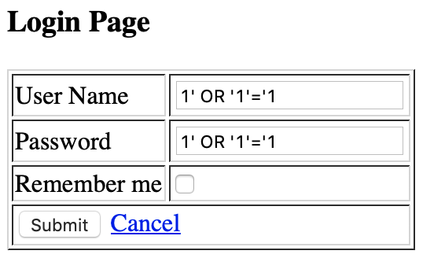
Task 1
Perform the login in your webapp without knowing username and password.
Notes:
The proposed ranking is based on years of experience that Gary McGraw acquired by applying touchpoints to many different types of organizations ranging from independent software vendors to huge credit card consortium

Slide 47
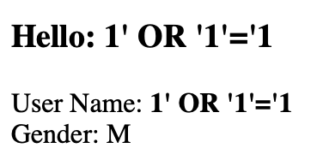
Solution
Perform the login without knowing username and password.
Notes:
The proposed ranking is based on years of experience that Gary McGraw acquired by applying touchpoints to many different types of organizations ranging from independent software vendors to huge credit card consortium

Slide 48
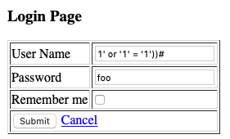
Task 2
Replace the SQL query creation with the following
String sql = "Select a.User_Name, a.Password, a.Gender from User_Account a
where ((a.User_Name = ‘"+userName+”’) and (a.password=MD5("+password+”)))"
Which query will be executed in the database?
Notes:
The proposed ranking is based on years of experience that Gary McGraw acquired by applying touchpoints to many different types of organizations ranging from independent software vendors to huge credit card consortium

Slide 49
Task 2
Replace the SQL query creation with the following
Select a.User_Name, a.Password, a.Gender from User_Account a
where ((a.User_Name = ‘1‘ OR ‘1’=‘1’))#)AND (a.Password=MD5(foo)))
Notes:
The proposed ranking is based on years of experience that Gary McGraw acquired by applying touchpoints to many different types of organizations ranging from independent software vendors to huge credit card consortium

Slide 50

Task 3 – Stacked Queries
Depending on the API that the web application is using and the DBMS it may be possible to execute multiple queries in one call.
Consider the following query:
10; INSERT INTO USERS(…)
Notes:
The proposed ranking is based on years of experience that Gary McGraw acquired by applying touchpoints to many different types of organizations ranging from independent software vendors to huge credit card consortium

Slide 51
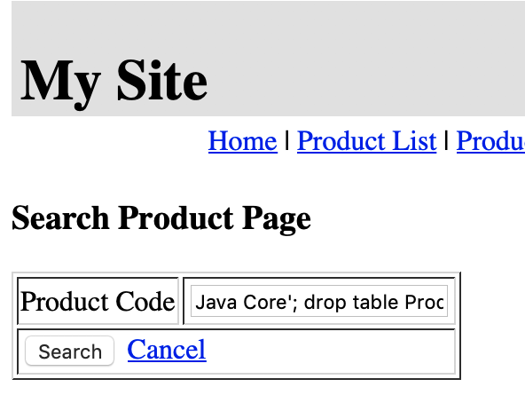
Task 3
You should now be able to delete all products in your web application.
Java Core'; drop table Product;#
Notes:
The proposed ranking is based on years of experience that Gary McGraw acquired by applying touchpoints to many different types of organizations ranging from independent software vendors to huge credit card consortium

Slide 52
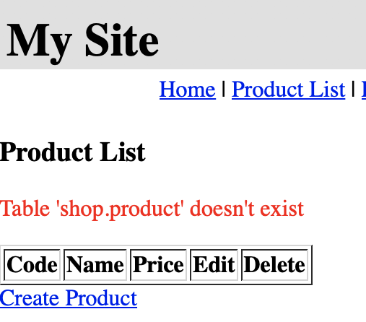
Task 3
Result: If you click Product List you can see that table Product was deleted
Notes:
The proposed ranking is based on years of experience that Gary McGraw acquired by applying touchpoints to many different types of organizations ranging from independent software vendors to huge credit card consortium

Slide 53
Advanced MySQL Injection Techniques

Slide 54
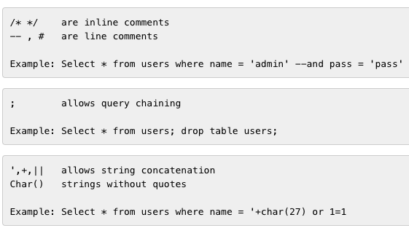
Special Characters
Notes:
The proposed ranking is based on years of experience that Gary McGraw acquired by applying touchpoints to many different types of organizations ranging from independent software vendors to huge credit card consortium

Slide 55

Special Statements
UNION
allows overlapping of database tables
Select a.CODE, a.NAME, a.PRICE from PRODUCT a where a.Name='Java Core' UNION ALL SELECT USER_NAME,PASSWORD,1 FROM USER_ACCOUNT;
Notes:
The proposed ranking is based on years of experience that Gary McGraw acquired by applying touchpoints to many different types of organizations ranging from independent software vendors to huge credit card consortium

Slide 56
Special Statements
JOIN
allows connecting results to those of other tables
Notes:
The proposed ranking is based on years of experience that Gary McGraw acquired by applying touchpoints to many different types of organizations ranging from independent software vendors to huge credit card consortium

Slide 57
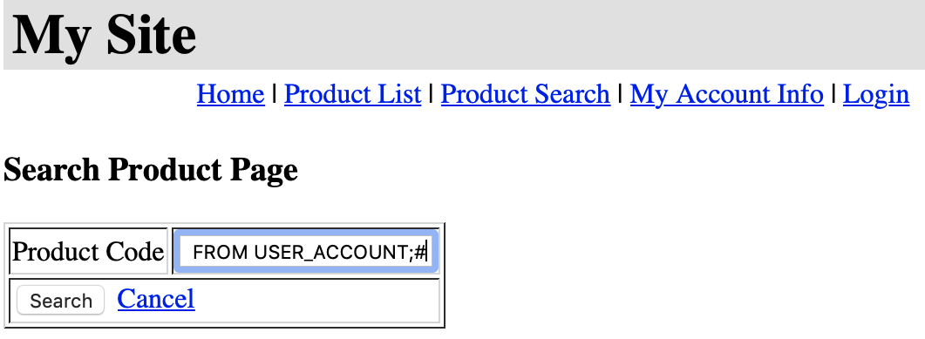
Task 4
Use the search product function in your web application to spoof the credentials of existing users.
Java Core' UNION ALL SELECT USER_NAME,PASSWORD,1 FROM USER_ACCOUNT;#
Notes:
The proposed ranking is based on years of experience that Gary McGraw acquired by applying touchpoints to many different types of organizations ranging from independent software vendors to huge credit card consortium

Slide 58
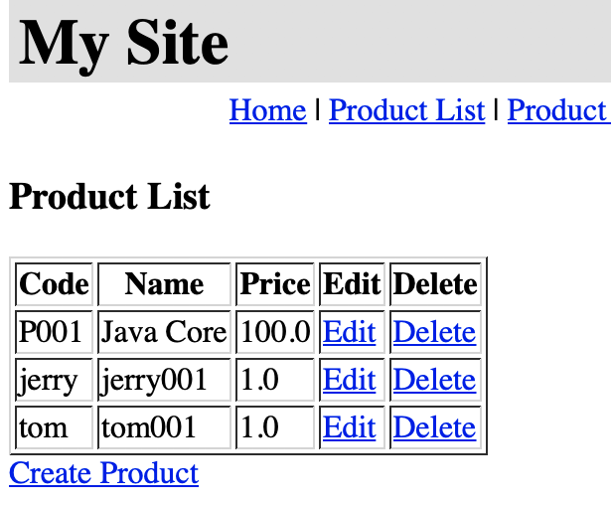
Result
Notes:
The proposed ranking is based on years of experience that Gary McGraw acquired by applying touchpoints to many different types of organizations ranging from independent software vendors to huge credit card consortium

Slide 59
SQL Injection - Automation
Most of the situations and techniques presented here can be performed in an automated way.
An example of such tools is SQLMap
https://www.owasp.org/index.php/Automated_Audit_using_SQLMap
Notes:
The proposed ranking is based on years of experience that Gary McGraw acquired by applying touchpoints to many different types of organizations ranging from independent software vendors to huge credit card consortium

Slide 60
Remediation Techniques

Slide 61

Immutable Queries
Best defense against SQL Injection
They either do not have data that could be interpreted
They treat data as asingle entity that is bound to a column without interpretation
Notes:
The proposed ranking is based on years of experience that Gary McGraw acquired by applying touchpoints to many different types of organizations ranging from independent software vendors to huge credit card consortium

Slide 62
Parameterized Queries
Prepared statements ensure that an attacker is not able to change the intent of a query even if SQL commands are inserted by an attacker. In the safe example below
The parameterized query would not be vulnerable and would instead look for a username which literally matched the entire string
tom’ or ‘1’=‘1
Notes:
The proposed ranking is based on years of experience that Gary McGraw acquired by applying touchpoints to many different types of organizations ranging from independent software vendors to huge credit card consortium

Slide 63
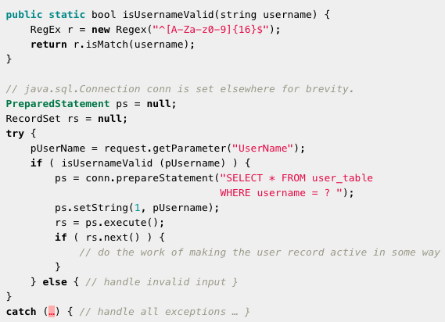
Parameterized Queries - Example
Notes:
The proposed ranking is based on years of experience that Gary McGraw acquired by applying touchpoints to many different types of organizations ranging from independent software vendors to huge credit card consortium

Slide 64
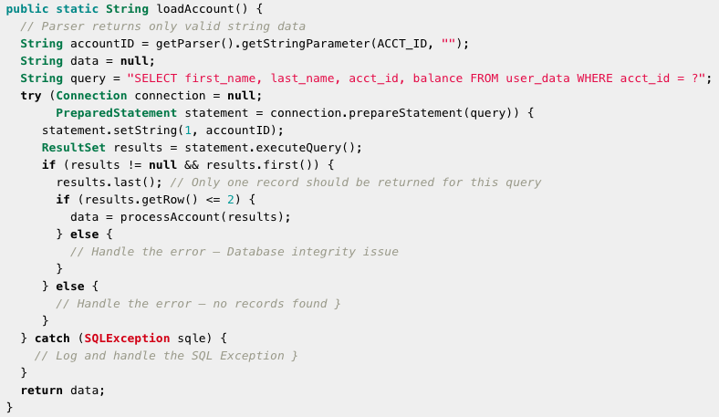
Parameterized Queries - Example
Notes:
The proposed ranking is based on years of experience that Gary McGraw acquired by applying touchpoints to many different types of organizations ranging from independent software vendors to huge credit card consortium

Slide 65
Stored Procedures
The difference between prepared statements and stored procedures is that the SQL code for a stored procedure is defined and stored in the database itself, and then called from the application.
DELIMITER //
CREATE PROCEDURE query(IN uName VARCHAR(20), IN pwd VARCHAR(20))
BEGIN
SELECT USER_NAME, PASSWORD FROM USER_ACCOUNT
WHERE USER_NAME = uNAME AND
PASSWORD = pwd;
END //
Notes:
The proposed ranking is based on years of experience that Gary McGraw acquired by applying touchpoints to many different types of organizations ranging from independent software vendors to huge credit card consortium

Slide 66
Validate Your Input/Output
Does your input contain characters and words that are often used in SQLInjection inputs?
’, +, #, --, JOIN, UNION,;
Check whether the number of outputs returned by a database query is not bigger or smaller than expected.
Notes:
The proposed ranking is based on years of experience that Gary McGraw acquired by applying touchpoints to many different types of organizations ranging from independent software vendors to huge credit card consortium

